Slide 1



ENVIRONMENTAL IMPACT
OF
FOOD PRODUCTION
D a t a
A n a l y s i s a n d I n s i g h t s
Elias Dogbatsey

Slide 2


Problem Statement
Objective: Analyze the environmental impact of various food products.
Key Questions:
Which food products have the highest greenhouse gas emissions?
How do plant-based and animal-based foods compare in terms of environmental impact?
What are the key drivers of emissions in
food production?

Slide 3



Data Overview
Dataset: 43 food products, 23
columns.
01
Key Metrics:
Total emissions (kgCO₂eq).
Land use (m² per kg).
Water usage (liters per kg).
Eutrophying emissions (gPO₄eq per kg).
02
Missing Data Handling:
Dropped columns with > 35% missing
values.
Imputed missing values using
group-based medians (animal vs. plant).

Slide 4




Key Insights
Land Use
Animal products require significantly more land.
Negative land use change (e.g., nuts, olive oil) indicates carbon sequestration.
Highest Emitters
Beef and lamb dominate total emissions.
Animal-based foods generally have higher emissions than plant-based.

Slide 5
Key Insights
Water Usage
Rice and diary products have higher footprints
Eutrophying Emissions
Animal feed and manure contribute to high eutrophication.

Slide 6
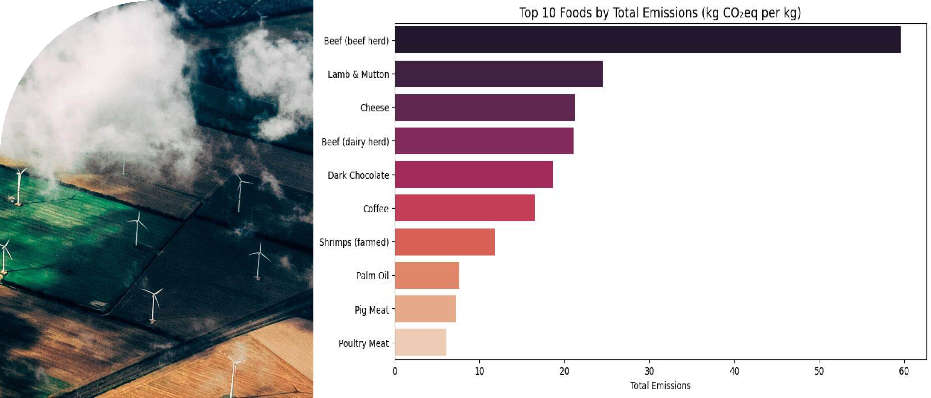
Top 10 Emitters

Slide 7
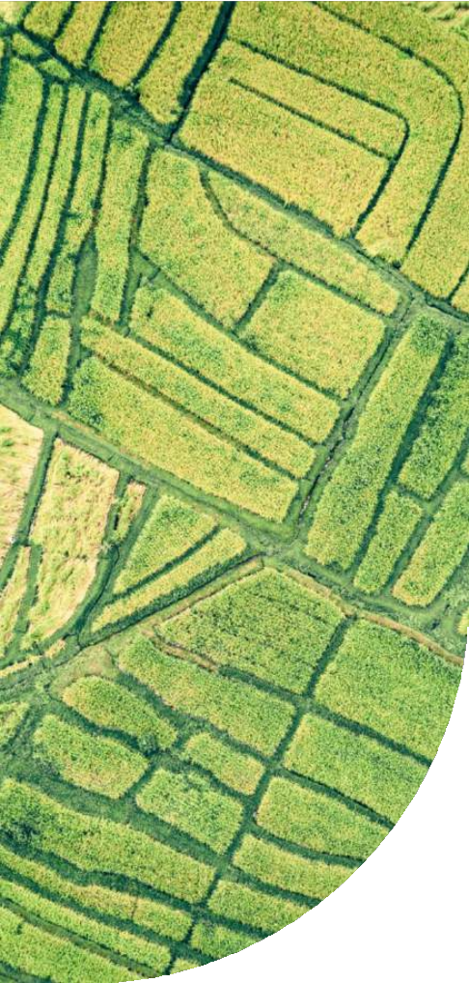





Recommendations
Reduce consumption of high-emission foods (beef, lamb, dairy).
Promote plant-based alternatives.
Shift Diets
Improve land management for carbon sequestration (e.g., nuts, olive oil).
Sustainable Farming
Policy
Actions
Tax high-emission foods.
Subsidize sustainable agriculture.

Slide 8


Conclusion
Summary:
Animal-based foods have a disproportionate environmental impact.
Data-driven insights can guide dietary and policy changes.
Next Steps:
Expand dataset to include more regional variations.
Model impact of dietary shifts on global emissions.

Slide 9


THANK YOU

